Slide 1

Intro to php

Slide 2

installation

Slide 3

Local server
Xampp
source: https://www.apachefriends.org/download.html
Video: https://www.youtube.com/watch?v=py4QusE9Lzc

Slide 4

PHP main syntax
Variables
If/else statements
Loops
Functions
Oop
Namespace
super global variable
Db connection
Regular Expression (Regular )

Slide 5
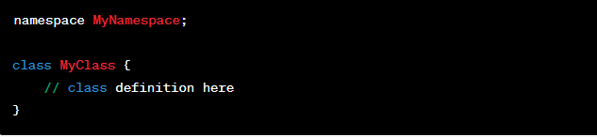
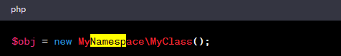
namespace
Namespaces allow you to define a group of related functions, classes, or constants with a unique name

Slide 6
superglobal variable
$_SERVER
$_GET
$_POST
$_SESSION
$_COOKIE
$_FILES
$_ENV

Slide 7
$_SERVER
$_SERVER['DOCUMENT_ROOT']: The root directory of the current web application.
$_SERVER['HTTP_HOST']: The host name of the current request.
$_SERVER['REQUEST_METHOD']: The HTTP request method (GET, POST, etc.).
$_SERVER['REQUEST_URI']: The URI of the current request.
$_SERVER['REMOTE_ADDR']: The IP address of the client that made the current request.
$_SERVER['SERVER_ADDR']: The IP address of the server.
$_SERVER['SERVER_NAME']: The name of the server.
$_SERVER['SERVER_SOFTWARE']: The name and version of the web server software.

Slide 8
$_ENV
putenv(“Kay=value");
$_ENV[Kay']

Slide 9
Db connection
MySQLi (object-oriented)
MySQLi (procedural)
PDO

Slide 10

Regular expressions
preg_match()
preg_replace(),
preg_split()

Slide 11

htaccess
Apache language

Slide 12

routing

